Slide 1
BMW of
San Francisco
SMB CASE STUDY
How One Wrong Business Listing
Can Mean Erroneous Listings Across the Web
BMW of
San Francisco

Slide 2
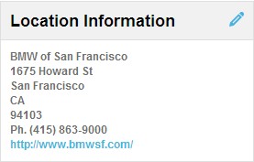
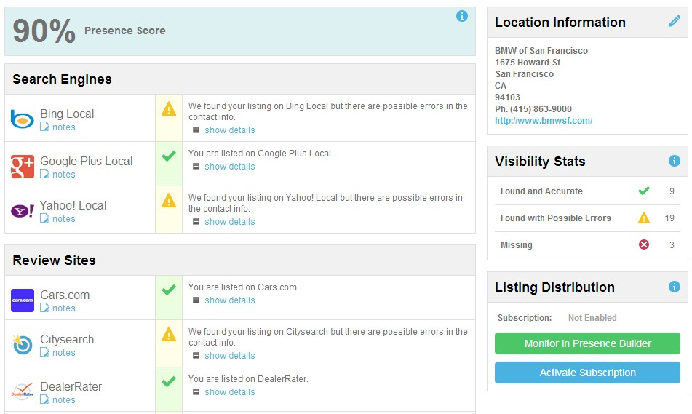
Case Study: BMW of San Francisco
Background
We ran an online reputation report on BMW of San Francisco, and noticed that they had the wrong address listed on many sites across the web. Sites like Facebook, Yellowpages and Foursquare were leading customers to an incorrect address.
BMW of San Francisco’s online visibility
The store owner entered their correct information online. This is the same information that was found on many listing sites and directories.
Despite a fairly high presence score, many sites reported the wrong address. From search engines to review
sites, directories to social sites, BMW’s address was consistently coming up incorrect.
Where do listings come from?
Google and other search engines get business listing information from many sources, including:
business owners enter their own information
government sources
user-generated content (UGC)
Google sources (MapMaker, Places, etc)
data providers
This information is all compiled in Google’s server cluster, and can be verified by a Google employee. The most importantly weighted information in the US, however, comes from the four major data providers
— Neustar/Localeze, Infogroup, Acxiom and Factual. These providers disseminate their listing information to over 300 listings sites — Yelp, yp.com, judy’s book and many others.

Slide 3
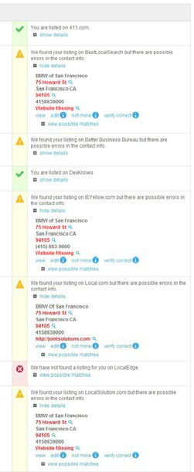
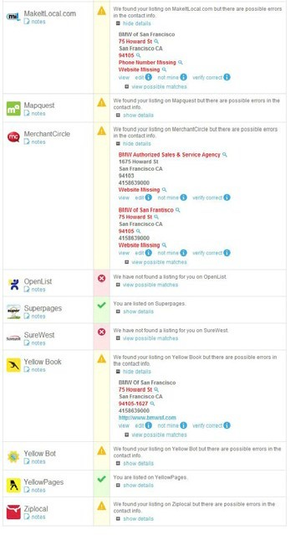
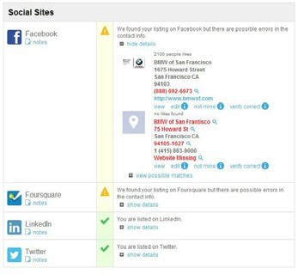
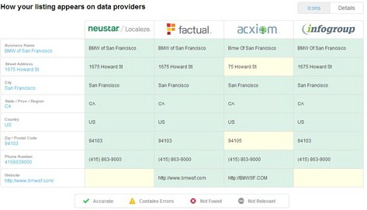
Case Study: BMW of San Francisco
The why
When we looked at how BMW of San Francisco’s listing appeared on the four major data providers, we found that there were discrepancies with their listing and what Acxiom was reporting. When we further delved into the “details” section, it became clear that Acxiom was reporting the wrong address that had been seen on so many listing sites — 75 Howard Street.
Recurring erroneous listing: 75 Howard Street
Recurring erroneous listing:
75 Howard St
BMW of San Francisco had their information correct on three out of the four major dataproviders, but their address was listed incorrectly in many places. It’s not
enough to work with one, two, or even three of the four major data providers. When a business has incorrect information on even one of these major web influences, that information is disseminated all over the web.
The Solution — Listing Distribution
Listing Distribution is part of our Listing Builder software. Listing Builder has several components that help businesses improve local search, reach consumers and correct and verify business listing information. We partner with all four major listing data providers — Factual, Acxiom, Infogroup, and Neustar (Localeze) — which are trusted by more than 300 listing directories, from prominent networks such as Urbanspoon to major auto manufacturers using it in their navigation systems. Our system ensures correct business listing information with all four providers, and transparency reporting when that data is taken up.

Slide 4
Can they find you, or will they drive on by?
Be sure you’re found through accurate online listings with Listing Distribution
Learn more about how our Digital Solutions can increase YOUR business. Contact us today!

